Slide 1

Liar Game

Slide 2
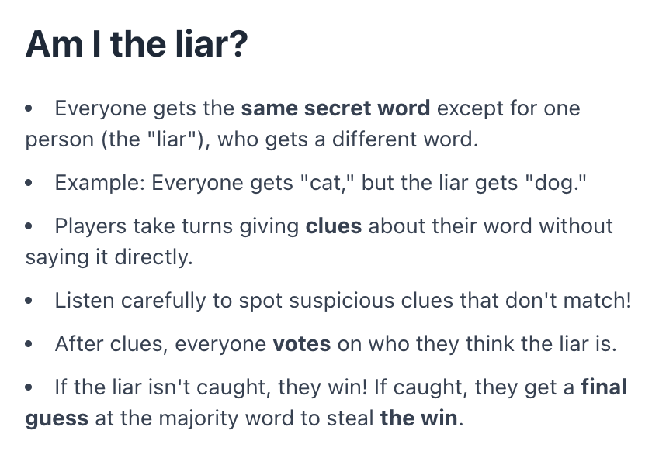

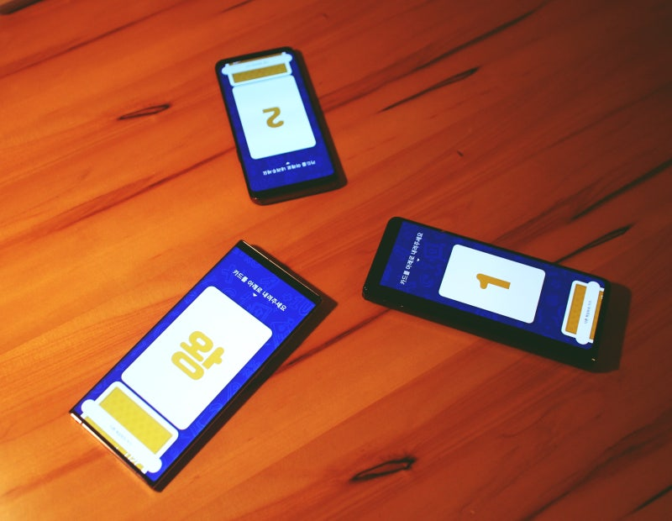
Inspiration

Slide 3
Demo
amitheliar.vercel.app

Slide 4
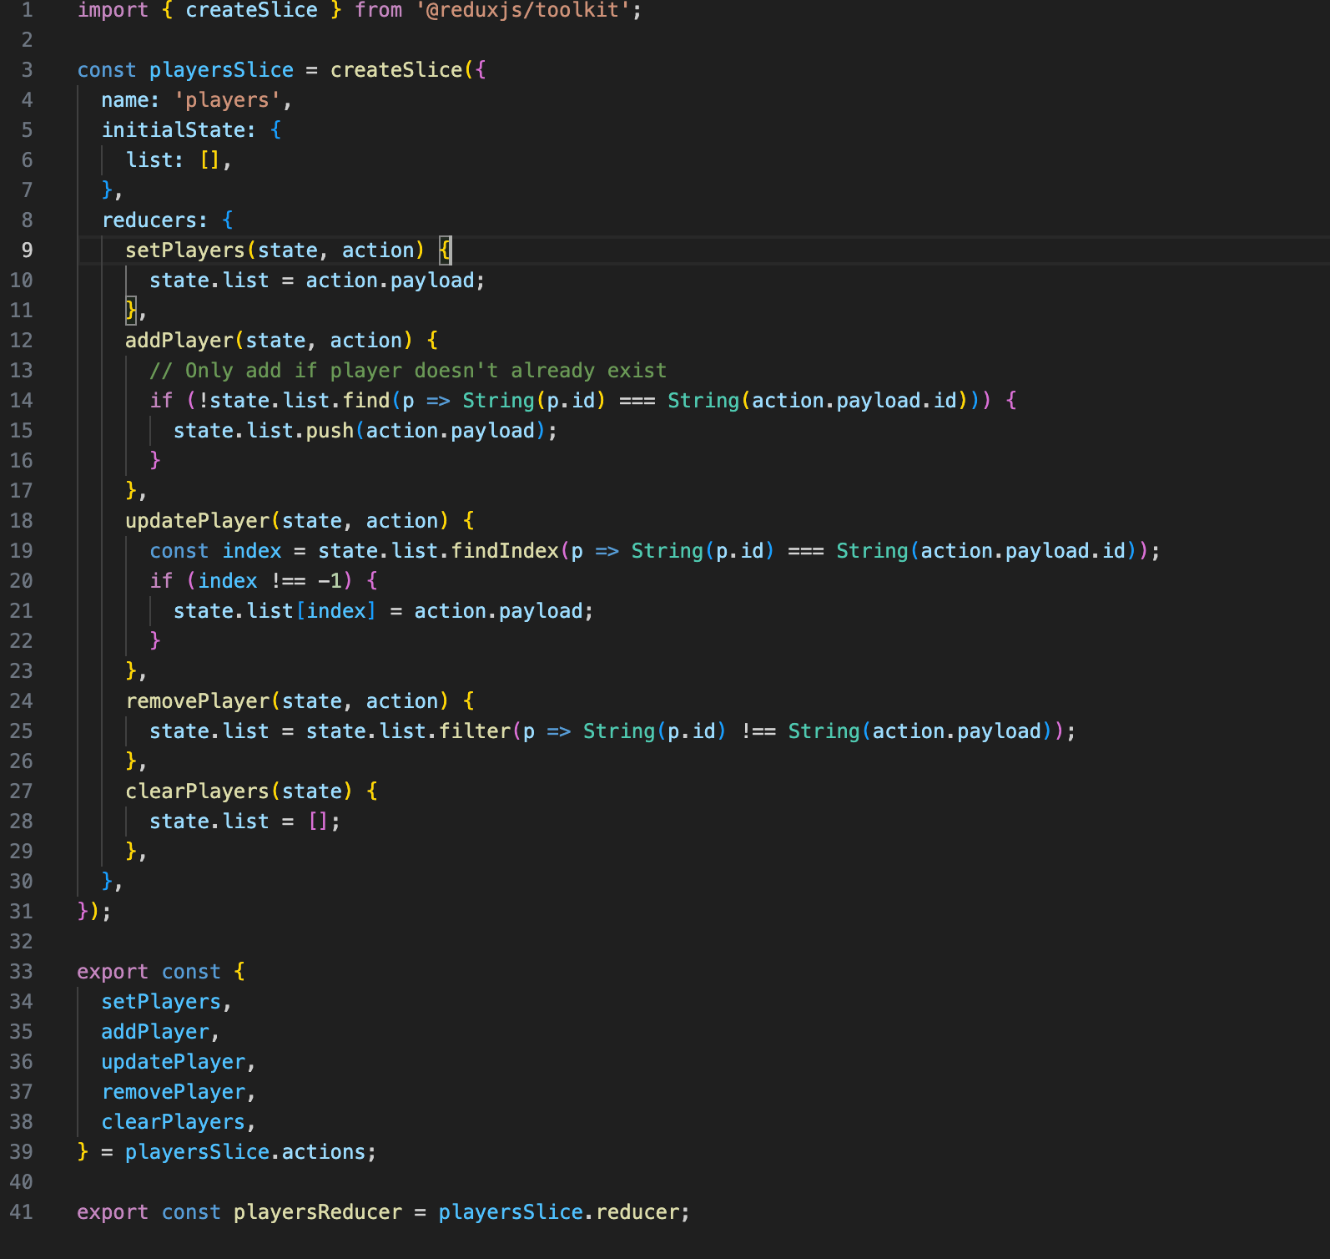
Snippet of Code
Redux reducers

Slide 5
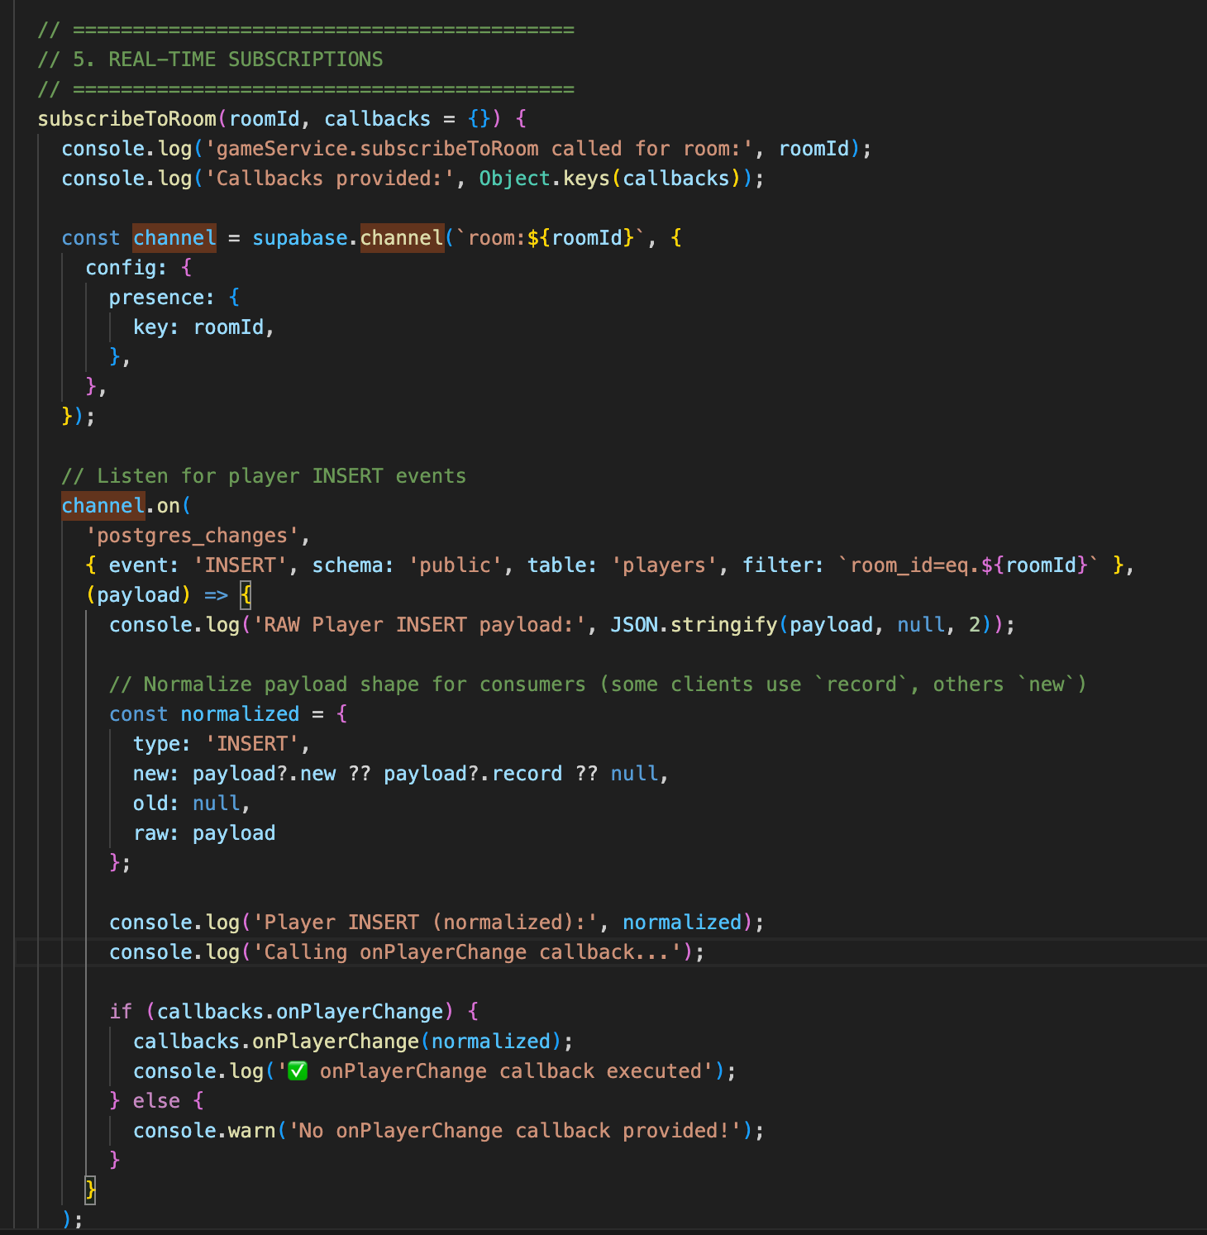
Snippet of Code
Websocket Connection

Slide 6


Concepts that was used
React
  Props
  useState
  useEffect
  Conditional rendering
PostgreSQL
Supabase- Real time Database
Vercel- host website
Use Redux tool kit
Async logic and error logic
  Players can turn off their phones/ check on different apps

Slide 7

Improvements
Player suggestions
  receive user input
More Categories

Slide 8

Thank you
Derek Kim
12 2025

